Slide 1

LSM Project walkthrough
Team Mendit

Slide 2
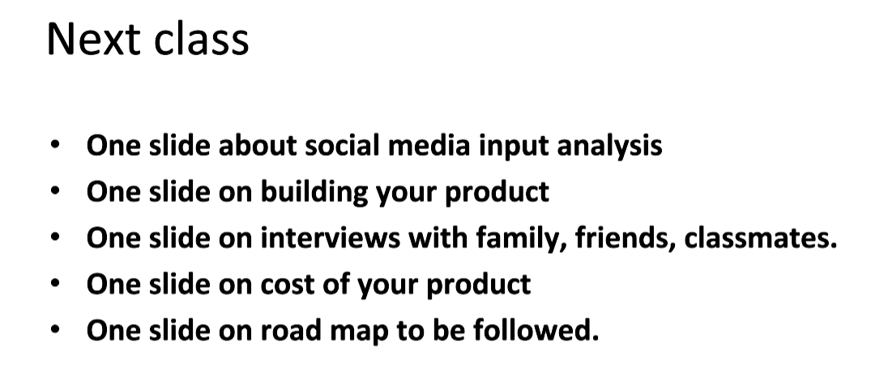
Mendit
Company Description
• Company Name - MendIT
• Type of business structure – Partnership
• Ownership/management team- VIT group members, Investors, other stakeholders

Slide 3
Mission
• Mission Statement- Our aim is to inject technology, accessibility and professionalism to the working force by creating a curated platform for unorganized services and a reliable high-quality service at people’s doorsteps.
• Product/services and target market Our Platform is an e-commerce marketplace for household and professional services with many categories of services, including handymen (plumbers and electricians), cleaning, electrical, farming and document services.

Slide 4
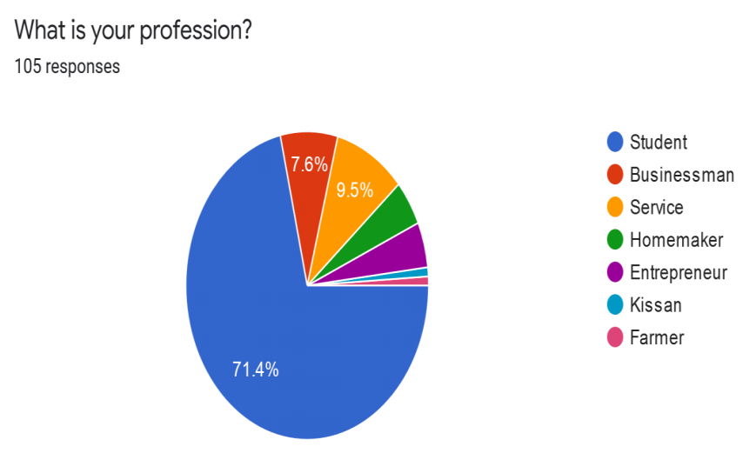
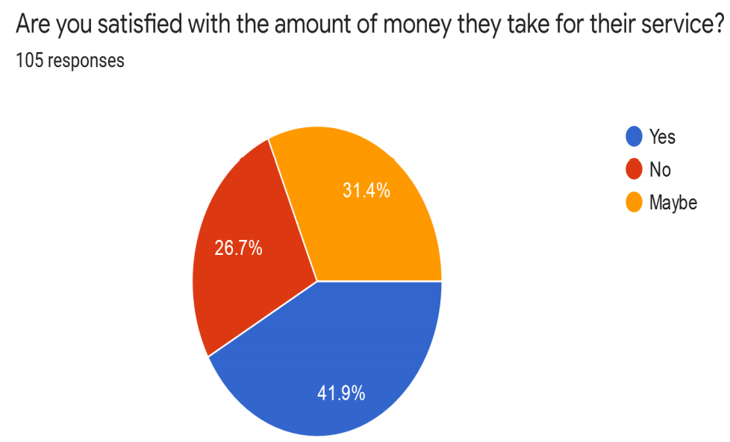
Marketing surveys conducted and their analysis:
To get an idea of the market we conducted a local survey around the Vit Campus while also incorporating people from different professions to get an idea regarding the various requirements of the Market.

Slide 5
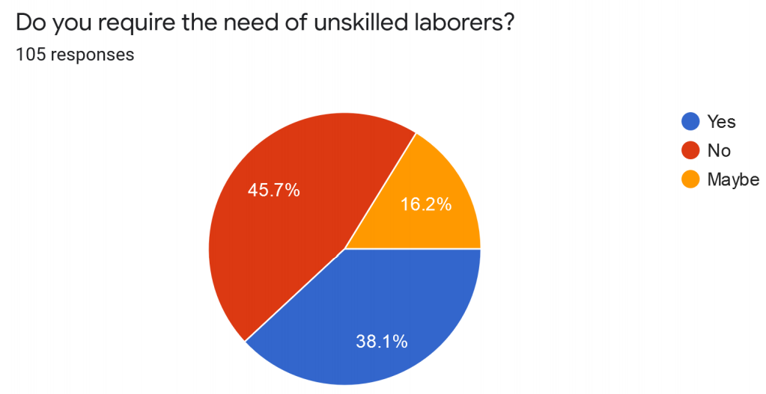
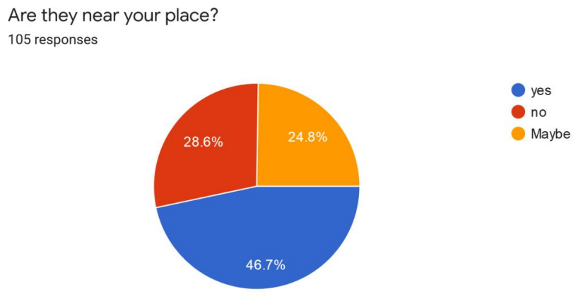
While a huge percentage of the audience of the survey were students, we were also able to get responses of few Farmers, Homemakers, people working in jobs and independent Businessman and Entrepreneur.

Slide 6
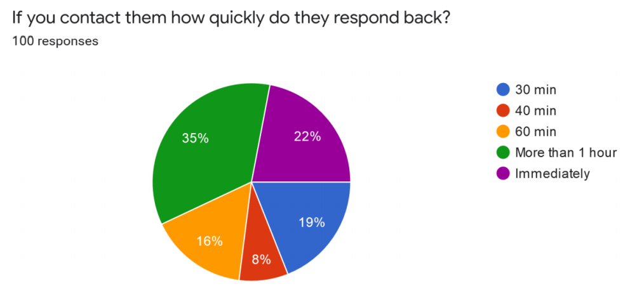
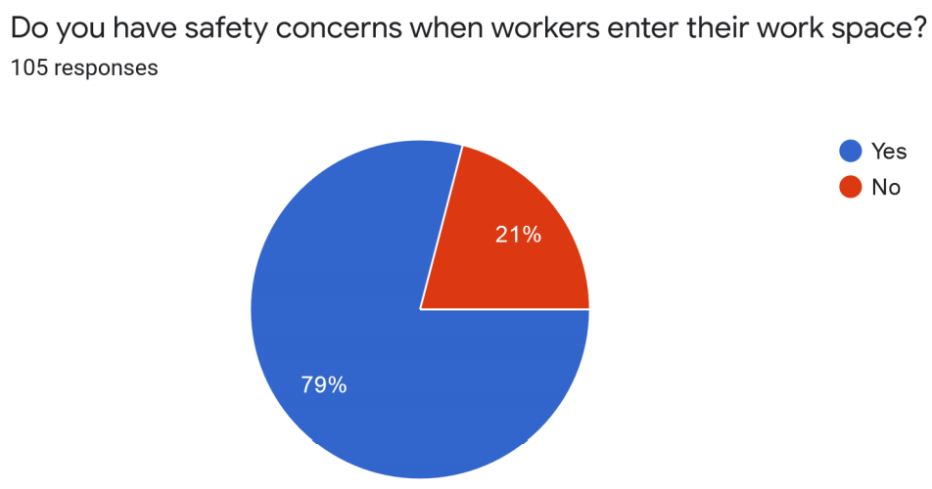
• According to the survey we came across a disturbing trend where nearly half of our target audience indicated that they did not require the need of unskilled laborer's. On a further deep analysis of the individual answers we found that it was only the student community that had a very mixed opinion regarding the need of unskilled laborer. We found that all the people of the other professions did require unskilled laborer. We were able to get in touch with a few of them through phone and found out that there is always a need of an unskilled employee. Farmers in particular told how much they have problem in finding laborer during the cutting period of crops.
• This result and analysis helped us to conclude that there indeed is a demand for the project. Few trends we noticed regarding the past experiences of the people with the unskilled employees.

Slide 7
Market Analysis
MendIT which is a service provider has a lot of market scope in the existing scenario. Shortage of workers in many cities mostly metropolitan is very high, which is not primarily due to the lack of workforce but due to the existing workforce not being organized. The existing options do not have a well-defined structure to benefit both the user and the worker. Hence our product which offers symbiotic relation between the user and worker.
• MARKET SIZE- India has millions of skilled and semi-skilled people who are going to benefit from this service. The market size for our product is larger than most of the internet-based companies.
• MARKET TRENDS- The service providing sector has seen a tremendous rise in the recent years due to wave of digitalization in India. If the current trends are to be considered an indication, this industry is expected to grow.
• MARKET PROFITABILITY- For now, if a person needs a service, he has to search for the appropriate person which is time consuming and expensive. Also, the worker may charge according to his wish. This problem would be solved by our product as we would provide the details of all the workers to the user and new jobs to the worker.

Slide 8
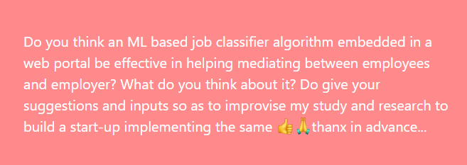
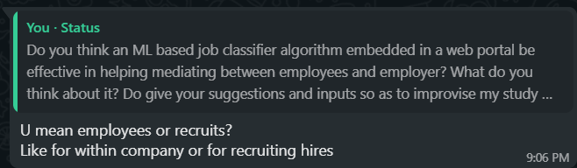
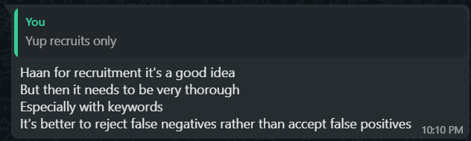
WhatsApp and Facebook survey/ interaction also done 50+ responses:

Slide 9
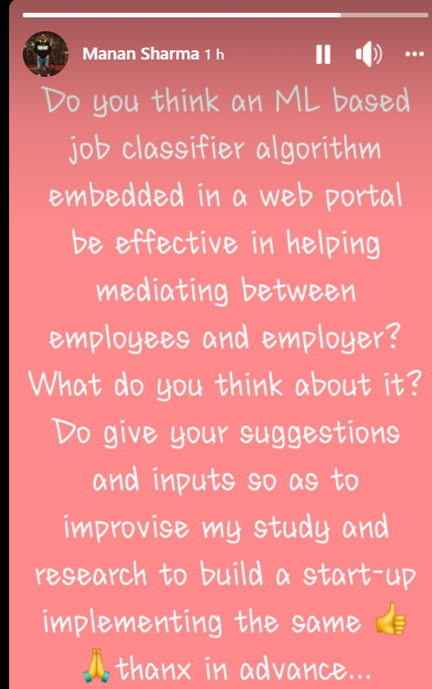
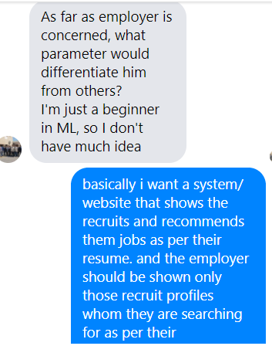
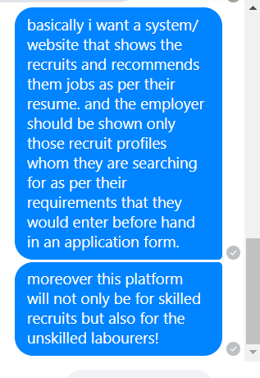
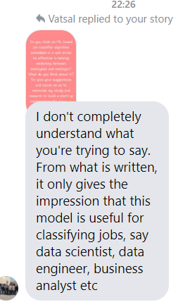

Slide 10
Discussion with family members.
I had a discussion about the project with my parents. They thought it was a good idea, as there is definitely a dearth of applications to hire unskilled workers. My parents, also told me about the problems they faced while hiring a domestic help a few years back. The process of acquiring their services was cumbersome due to the agencies involved. They said that this project will be able to effectively cut out the middle-man, thus ensuring a fast and efficient method to hire workers. One problem, they pointed out, that our project should handle, should be verifying the authenticity of the workers on our platform. This is essential in order to gain the users trust, which will automatically increase the popularity of our application.

Slide 11
Building process and outcomes of Mendit web portal-
We will have a basic layered architecture of our system application that is an ML classifier algo embedded web portal named after our team Mendit. On the basis of the core nature and viewability of the component to the users/ customers the architecture will be built as shown in the following slide.

Slide 12
Layered architecture expected (Mendit):
Terms and conditions, privacy and security of the web portal
Help/ feedback mechanism of the portal
GUI, Frontend and Client side Application
Backend and ML classifier algorithm

Slide 13
Functional architecture
Client
Client authenticates using
credentials and does other
activities including input of data and resumes or cv.
We also tend to provide
a feedback cum help or
suggestion module/ functionality
to interact with the users more.
Mendit web portal functionalities-
Application level GUI of the portal
Terms conditions and constraints on validations and authentication
The terms conditions and the privacy
settings of the web application are binding
on the users and clients of the portal.
ML classifier algorithm
Feeding data and
recovering data from
the DB storage to save it for future use.
The data of the clients is also
fed into the classifier algorithm
from the backend DB
storage to train and test the dataset.
Core backend database

Slide 14
Inputs and suggestions by friends and family:
Family and friends suggestions:
Question 1: What do you think about the idea of the product?
Suggestions by family members:
Person one: I don't completely understand what you're trying to say. From what is written, it only gives the impression that this model is useful for classifying jobs, say data scientist, data engineer, business analyst etc.
Friend: As far as employer is concerned, what parameter would differentiate him from others? I'm just a beginner in ML, so I don't have much idea.
I from my one friend told: basically i want a system/ website that shows the recruits and recommends them jobs as per their resume. and the employer should be shown only those recruit profiles whom they are searching for as per their requirements that they would enter before hand in an application form.

Slide 15
Responses and conversation with friends recorded.
I: moreover this platform will not only be for skilled recruits but also for the unskilled laborer's!
Friend: So basically when a person inputs their resume, you will categorize them as per the suitable job and store that person's id. The recruiter only has to filter as per job requirement. It's a great idea. But what if a person is equally skilled in networks as well as AI. Will he be included in both categories or there will be a bias?
I: He will be included in both to be honest so no bias.
Friend 2: U mean employees or recruits? Like for within company or for recruiting hires?
I told: Yup recruits only.
Friend 2: Haan for recruitment it's a good idea But then it needs to be very thorough Especially with keywords It's better to reject false negatives rather than accept false positives.

Slide 16
Competitors
1.Justdial Justdial is an Indian based company that provides search services and is made available on Website and Mobile. It also provides the user with the details of all the service providers. The customers are required to call a hotline number and ask the operator what service they are looking for (e.g. restaurants, hospitals, banks etc.) and in which area. In turn the operator will send them an email and an SMS with the information. Apart from this, customers can search for the information of any specific business on the Website and Mobile Application.
2. INDIAMART IndiaMART InterMESH Ltd. is an Indian e-commerce company that provides B2C, B2B and customer to customer sales services via its web portal. The group began in 1996 when Dinesh Agarwal and Brijesh Agrawal founded the website IndiaMART.com, a business-to business portal to connect Indian manufacturers with buyers. The company is headquartered in Noida, Uttar Pradesh, India. Over the last 10 years, IndiaMART has become the largest e-commerce platform for businesses with about 60% market share.
3. Sulekha Sulekha is a digital platform for local service businesses in India, matching 20+ million consumers with 50,000 service professionals across 200 categories in about 40 cities. Sulekha focuses on expert services clustered around Home, Life and Self and where the user need is customized. Using technology and domain intelligence, the platform seeks to understand the user need in detail and matches it to verified service professionals who are profiled. The service is free to use for consumers and service professionals pay the platform for performance in the form of verified, matched service requests.

Slide 17
Cost of the product and revenue sources:
MendIT is a new friendly and fun place that offers everything for a dollar or less. It is a great place to visit and everyone leave happy without leaving broke.
• At MendIT we employee several measures to insure a steady flow of revenue.
• We will have a very nominal fee from the worker as well as the employer uses our platform to post an advertisement for a job posting. We will have advertisements on our app to make money.
• Even after that we will use investors’ money to make profit. Even different companies can approach to provide services on behalf of their company, and we can charge for that services. It is great platform to give jobs, we have job section in which anybody can provide its resume and get job opportunities. And even we can charge for that too. House selling and different opportunities will be provided in the near future.

Slide 18
Cost estimation:
Cocomo (Constructive Cost Model) is a regression model based on LOC, i.e. number of Lines of Code. It is a procedural cost estimate model for software projects and often used as a process of reliably predicting the various parameters associated with making a project such as size, effort, cost, time and quality. It was proposed by Barry Boehm in 1970 and is based on the study of 63 projects, which make it one of the best-documented models.
The early design model uses Unadjusted Function Points (UFP) as measure of size. This model is used at the early stages of software project when there is not enough information available about size of product which has t be developed, nature of target platform and nature of employees to be involved in development of projector detailed specifications of process to be used. This model can be used in either Application Generator, System Integration, or Infrastructure Development Sector.

Slide 19
Requirements H/W and S/W:
HARDWARE REQUIREMENTS
• Hardware Requirements
• Processor: Intel Pentium And Above Version
• Speed: 1.60 GHz
• Hard Disk: 20GB And Above
• Key Board: Standard
Software Requirements
• Operating System: Windows 10
• Data Base: MYSQLi
• Tools: JOOMLA, AJAX, PHP, JQUERY

Slide 20
Balance sheet and cost estimation:
One-time expenses
Permits and licenses
Incorporation fees
Logo design
Website design
Brochure and business card printing
Signage
Down payment on rental property
Improvements to chosen location
Ongoing expenses
Rent
Payroll
Taxes
Legal services
Loan payments
Insurance payments
Utilities
Marketing costs

Slide 21
Balance Sheet
• A balance sheet is a business statement that shows what the business owns, what it owes, and the value of the owner's investment in the business. The balance sheet is calculated at a specific point in time - at business start-up; at the end of a month, a quarter, or a year; or at the end of the business.
• A balance sheet is shown in two columns, with assets on the left and liabilities and owner's equity on the right. The total assets must equal total liabilities + total owners’ equity; that is, the totals must balance. This is called the accounting formula.
• Steps in Preparing a Business Start-up Balance Sheet
1. All the calculations in this spreadsheet are done as of the date of startup.
2. First, list the value of all the assets in the business as of the start-up date. This includes cash, equipment and vehicles, supplies, inventory, prepaid items (insurance, for example), value of any buildings or land owed. (Usually accounts receivable are included as an asset, but since the business has not started, there should be no amounts owed to the business).
3. Show the amount of the total assets on the left side.
4. Next, list all liabilities (amounts owed by the business to others), including business credit cards, any loans to the business at start-up, any amounts owed to vendors at start-up. Add up the total liabilities.
5. The difference between assets and liabilities is shown on the right side of the balance sheet as "Owner's Equity" (for an unincorporated business) or "Retained Earnings" (for a corporation). This amount is our investment in the business.

Slide 22
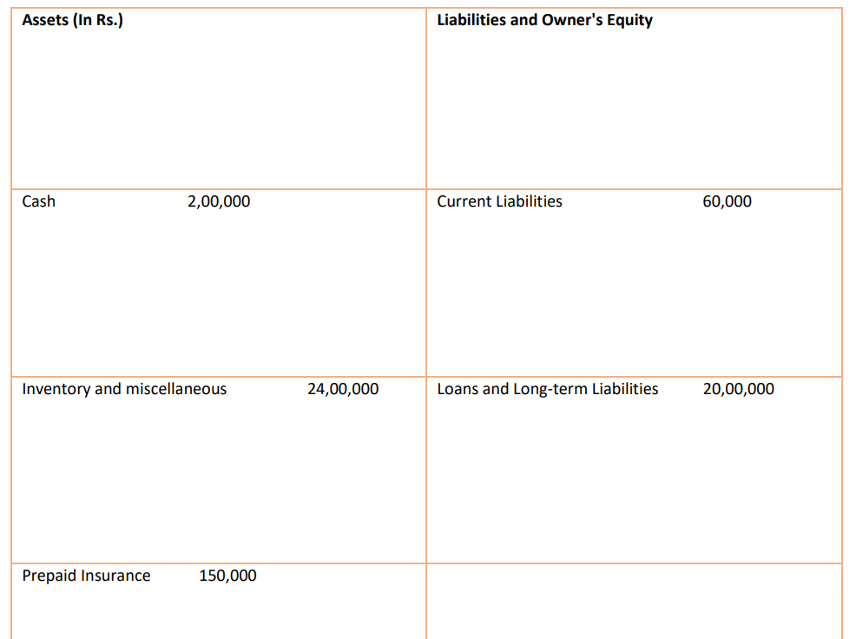

Slide 23
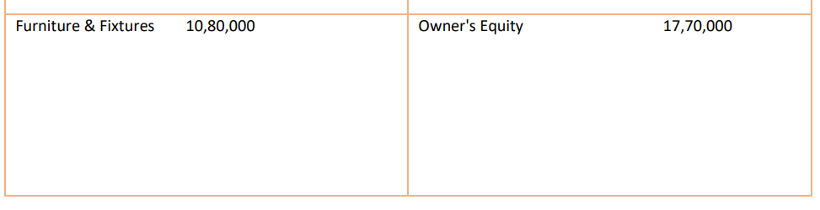
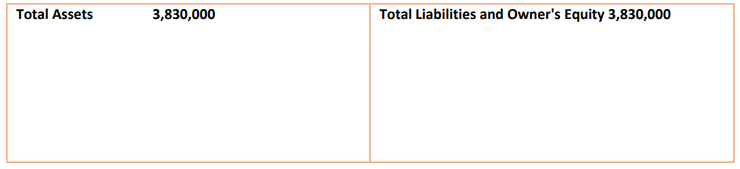

Slide 24
Analysis:
An analysis of this balance sheet shows that the owner has contributed Rs 17,70,000 in equity (mostly in cash and furniture/fixtures) toward the start-up of the business. The business is requesting a loan in the amount of 20,00,000 This money was spent on initial cash of 2,00,000, an inventory of products to sell of 24,00,000, and office furniture/computers, etc. valued at 10,00,000. In addition, the owner prepaid business and liability insurance of 1,50,000. Offsetting the assets are the liabilities and owner's equity. The current liabilities totally 60,000 are probably some debts owed to vendors for some of the office furniture. The long-term liabilities and loans are probably for the inventory and maybe furniture. Notice how the liabilities and owner's equity are tied to specific items in the asset column. This balance sheet gives a lender the picture of the position of the business as of the start-up date.

Slide 25
Road map to be followed for the completion of the Startup process and deployment:
Completion of analysis and requirement understanding.
Analysing requirements and requirement specification designing and risk analysis.
Coding and implementation design and GUI and backend.
Embedding ML algorithm and testing/ reviewing.
Legal matters and terms and conditions defined.
Build a Help and feedback system and maintainence

Slide 26
Coding and building prototype
Implementation of frontend and backend after UML requirement designing.
Collect non- functional and functional requirements
Elicitation of all the requirements
Embedding ML algorithm
Implementation of algorithm after collecting and training datasets.

Slide 27
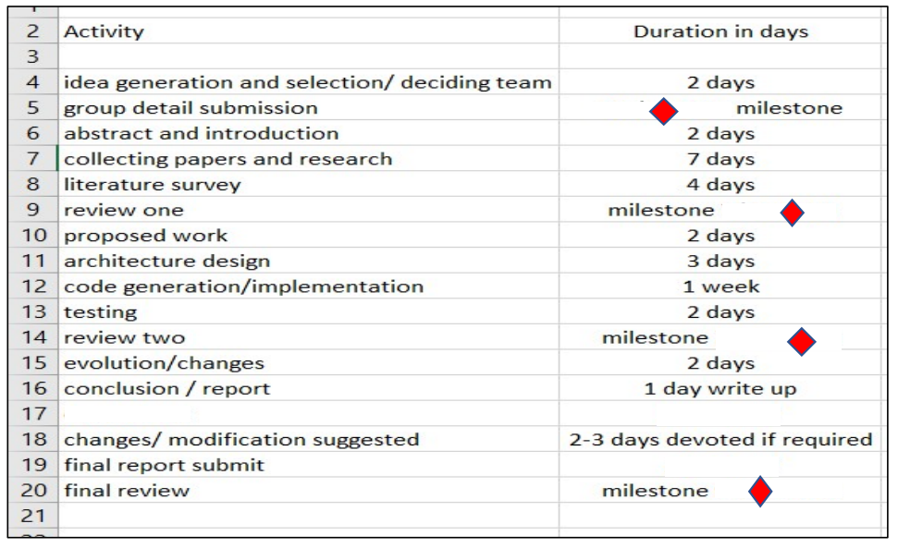
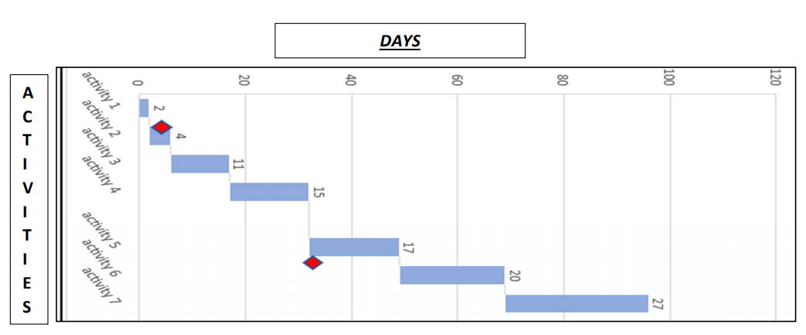
Activity duration and time estimation using a Gantt chart:

Slide 28
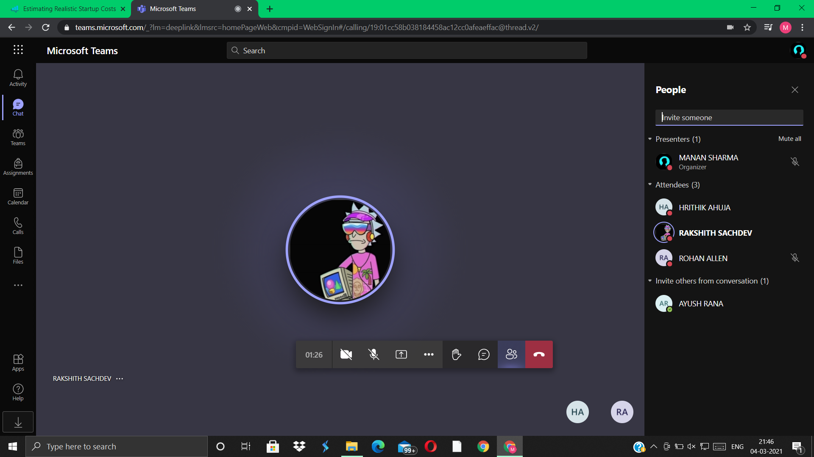

Slide 29
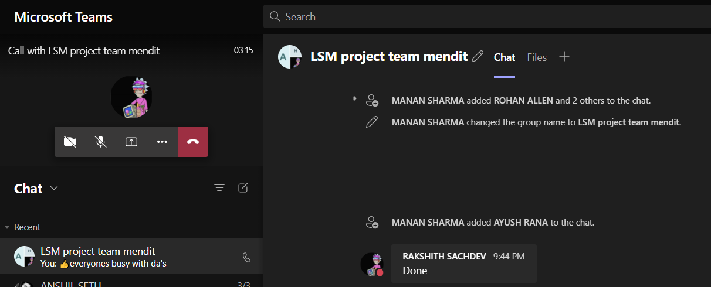

Slide 30
